Slide 1

Mastering Prompt Engineering
Unlocking the full potential of AI models.
1

Slide 2
"We are what we pretend to be, so we must be careful about what we pretend to be."
hhhgjhuyj
-Kurt Vonnegut, Mother Night
2

Slide 3
Agenda
What We'll Cover
The Fundamentals
How it Works
What is prompt engineering and why does it matter?
Understanding the mechanics of effective prompting.
Bridging the Gap
From Basic to Advanced
Connecting human intent with machine understanding.
Scaling your prompting skills for complex tasks.
3

Slide 4
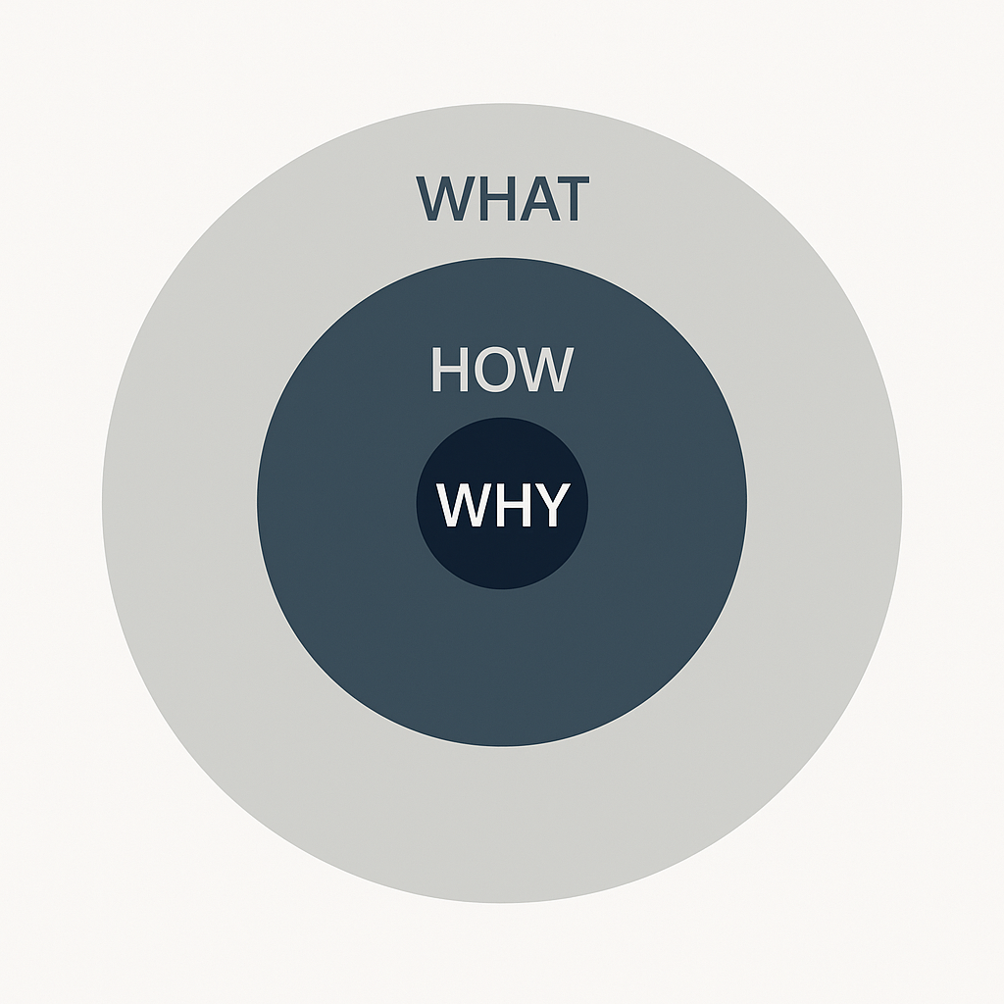
4

Slide 5
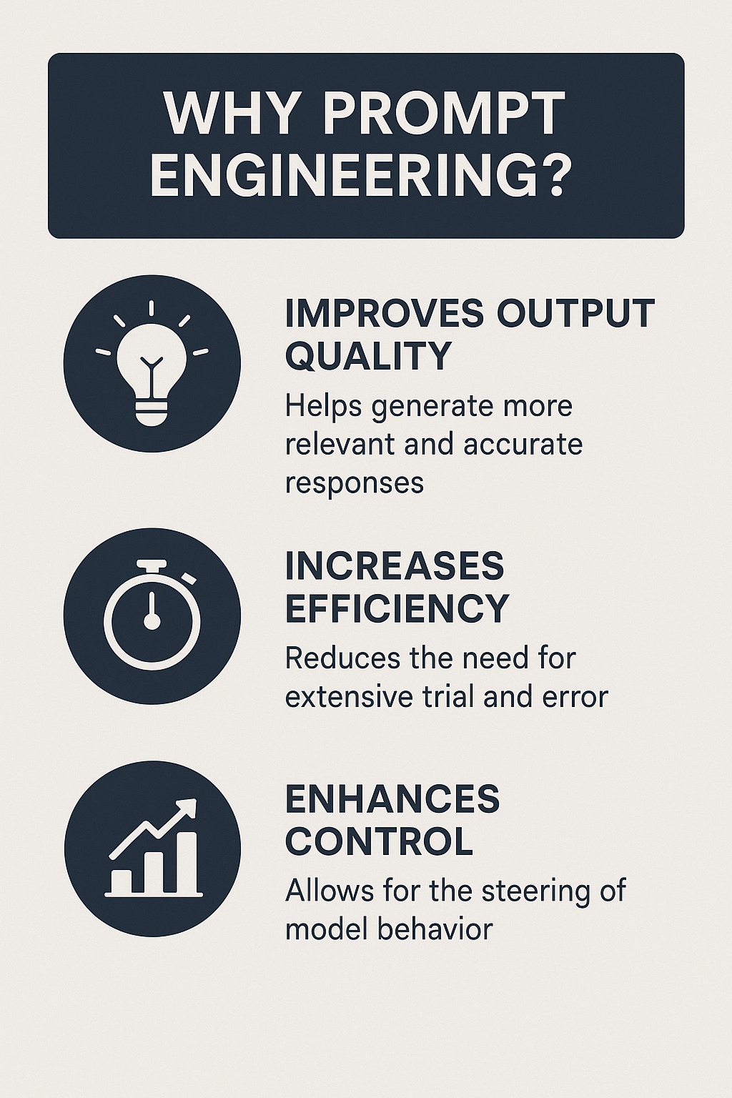




Why is Prompt Engineering Important?
Precision
Efficiency
Ensures AI generates accurate and relevant responses.
Reduces trial-and-error, saving time and resources.
Control
Innovation
Gives users greater command over AI behavior.
Unlocks new applications and capabilities of AI.
It transforms AI from a powerful tool into a precise instrument, tailored to your specific needs.
5

Slide 6
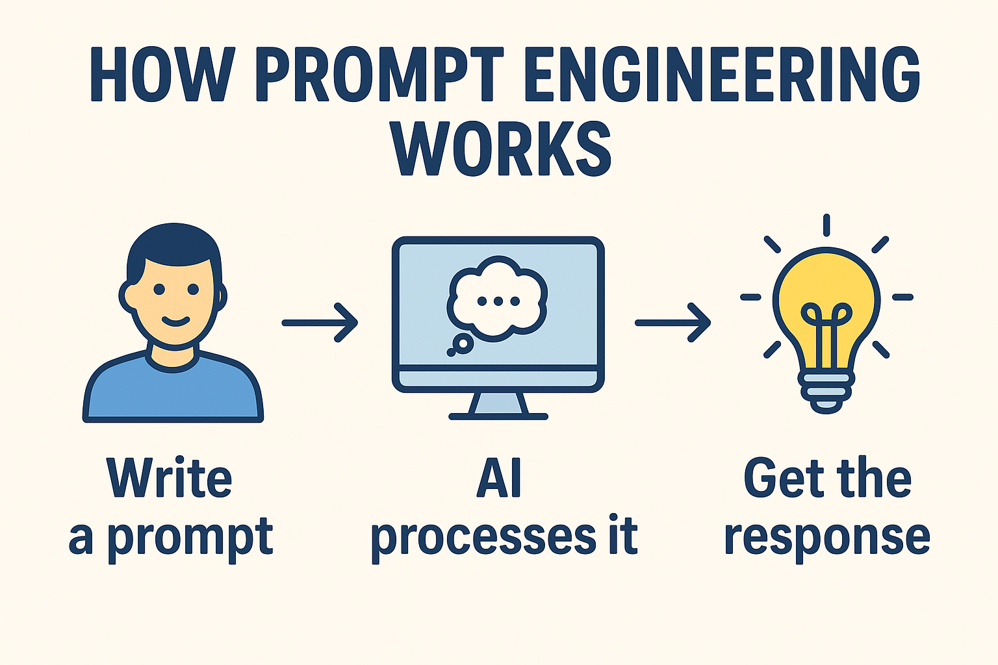
How Does Prompt Engineering Work?
At its core, prompt engineering works by providing clear, structured instructions and context to the AI model. Think of it as giving the AI a very specific set of directions.
Input
Processing
Your crafted prompt, including context, task, and constraints.
AI model interprets the prompt to understand intent.
6

Slide 7
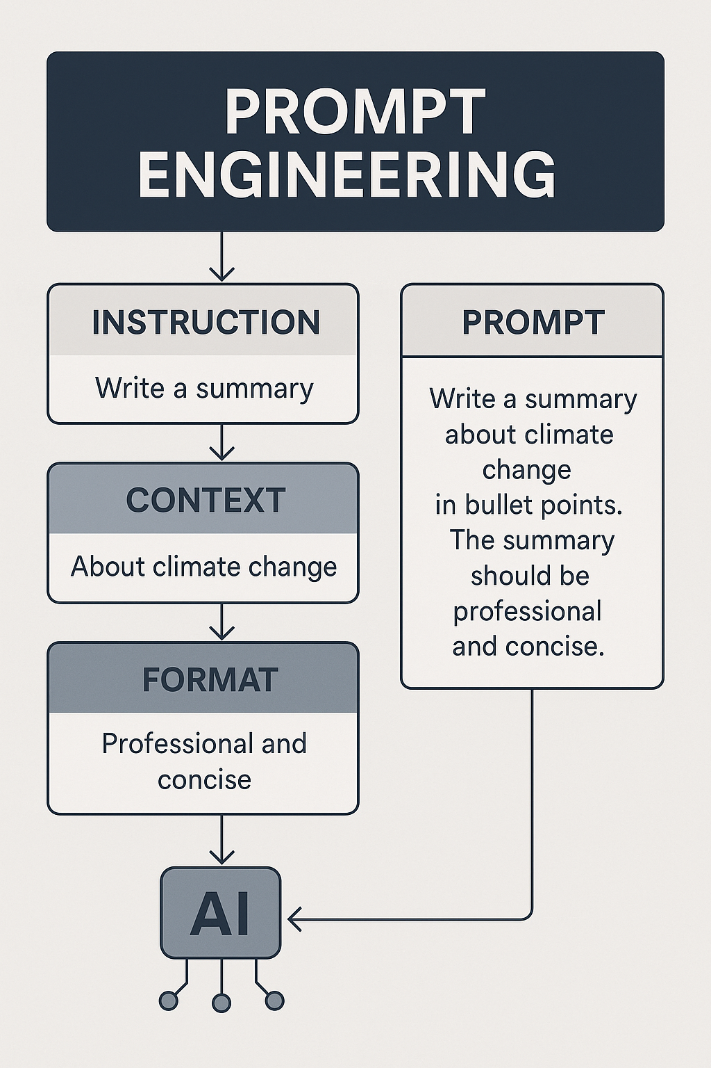
What is Prompt Engineering?
Prompt engineering is the art and science of crafting inputs (prompts) to guide AI models to generate desired outputs. It's about clear communication with machines.

Slide 8
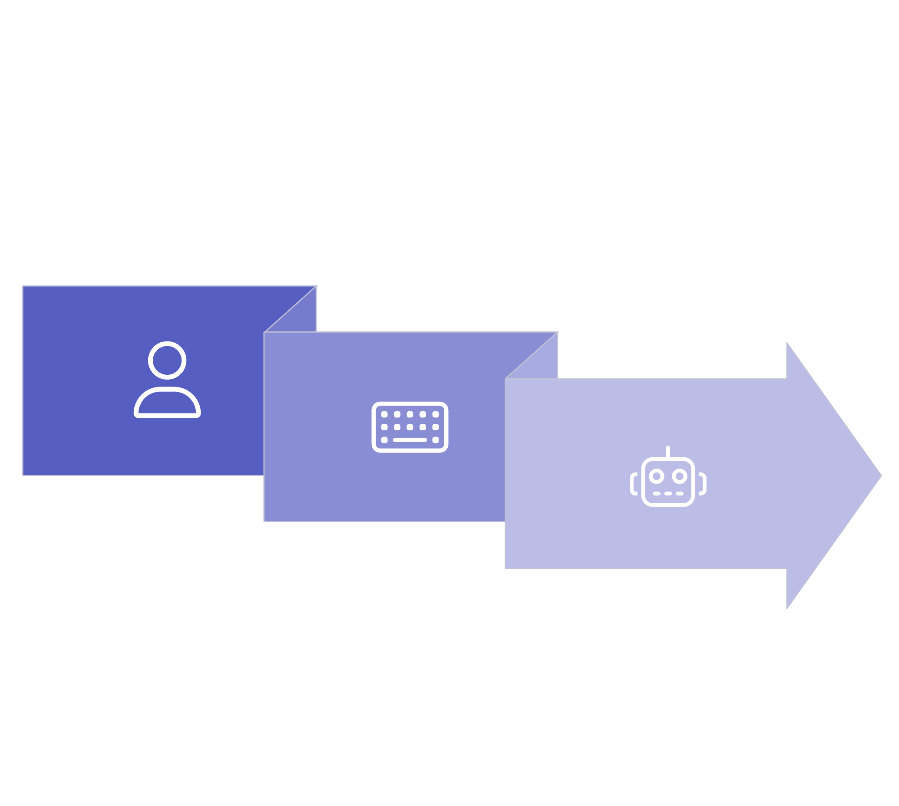



Purpose: Bridging the Gap
The ultimate goal of prompt engineering is to minimize the "say-do" gap between human intention and AI output.
Human Intent
Machine Understanding
Prompt Design
8
We translate complex human thought into a language the AI can accurately process and act upon, ensuring alignment.

Slide 9
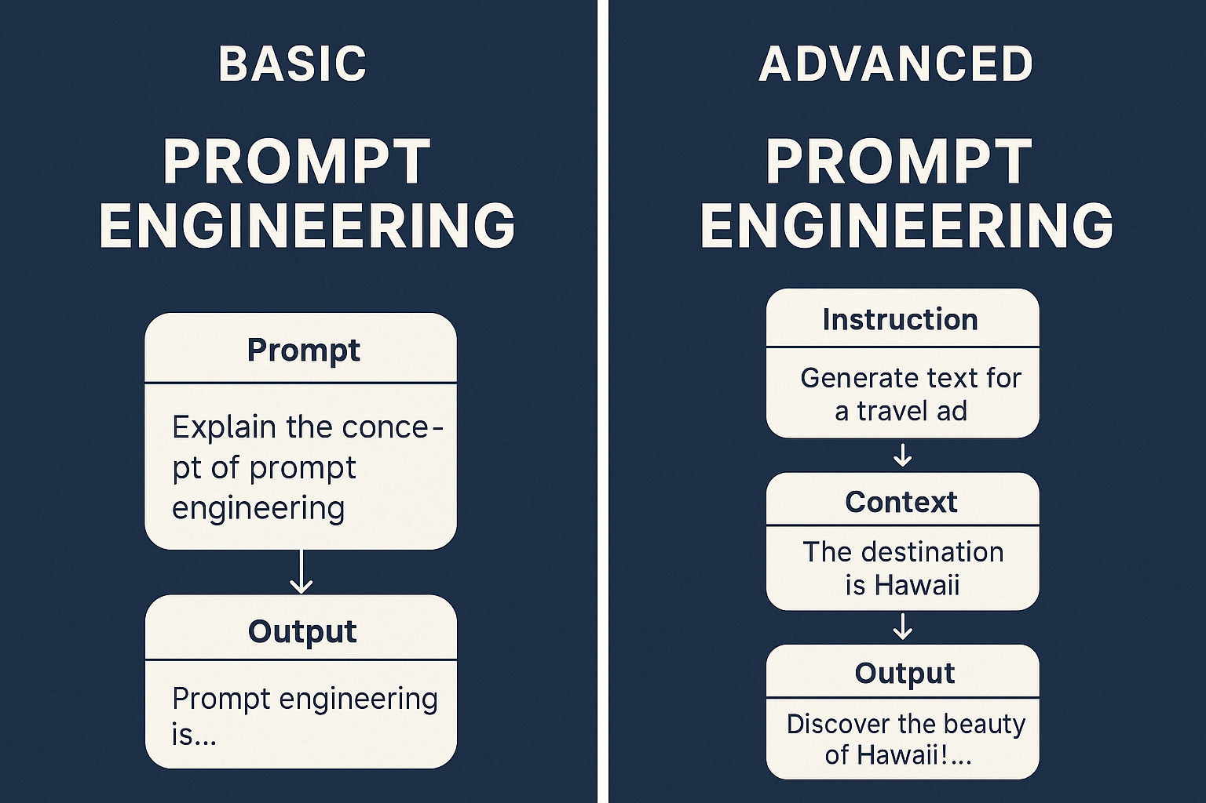
Basic vs. Advanced Prompts
Prompt engineering scales with complexity, moving from simple queries to sophisticated multi-turn interactions.
Basic Prompts
Advanced Prompts
Direct, single-instruction queries.
Multi-faceted, context-rich instructions.
Ask a question.
Role-playing for nuanced responses.
Generate a simple list.
Chain-of-thought prompting.
Summarize a short text.
Few-shot learning examples.
9

Slide 10



Conclusion
Embrace Iteration
Keep Learning
Practice Makes Perfect
Prompt engineering is an iterative process. Experiment and refine.
AI models evolve; stay updated with new techniques.
The more you prompt, the better you'll become at guiding AI.
Mastering prompt engineering empowers you to unlock the true potential of AI, transforming it into a precise and invaluable tool for any task.
10

Slide 11
Large Language Models (LLMs)
LLMs are smart computer programs that learn from lots of text and code. They can read, write, and understand language much like people do.
LLM: Stands for Large Language Model.
Where Are LLMs Used?
Customer Service: Chatbots that answer questions quickly.
Writing Help: Help writers make drafts or new ideas.
Coding: Suggest and fix computer code.
Education: Summarize long papers and create lesson plans.
11

Slide 12
How Do They Work?
Learning: LLMs study many books, articles, and websites to learn how language works.
Special Training: After learning a lot, they’re taught to be really good at certain jobs (like answering questions or translating).
What Can LLMs Do?
Create: Write new stories, articles, or code.
Chat: Talk with people in a natural way.
Analyze: Find main ideas or feelings in lots of text.
12

Slide 13
1.Beginner Level: What is Generative AI?
Generative AI is a kind of AI that creates new things.
Normal AI just recognizes stuff (like saying “this is a dog”), but generative AI can make a new picture, text, or sound.
Examples:
Text: Stories, poems, emails, or code.
Images: New photos or art.
Audio: Music, voice, or sound effects.
Video: Short or long clips.
Popular tools: ChatGPT (text), MidJourney, DALL‑E (images).
2. Intermediate Level: How Does It Work?
Generative AI learns patterns from huge amounts of data and then creates new things based on that knowledge. Steps:
Training: Learns from big data (texts, images, sounds).
Latent Space: Saves everything as a “map” of knowledge, where similar ideas are close.
Generation: When you give a prompt, the AI finds the right spot in the map and then creates something new, not just a copy.
13

Slide 14
3. Advanced Concepts: Types of Models
Transformers: Used in tools like ChatGPT. They understand context and create connected text.
GANs (Generative Adversarial Networks): Two AIs compete – one makes fake data, the other checks it. Both improve until outputs look real.
Diffusion Models: Start with “noise” and step by step turn it into a clear image (used in Stable Diffusion, MidJourney, DALL‑E).
RAG (Retrieval-Augmented Generation): Mixes trained AI with extra knowledge from databases so answers are more accurate.
4. Applications & Challenges
Multimodal AI: Works with many types at once (e.g., text + images).
Model Collapse: Risk if future AIs train on AI-generated data instead of human data.
Ethics & Risks: Copyright, fake news, deepfakes, jobs loss, and high energy use.
14

Slide 15
THANK YOU TO “ATMIYA UNIVERSITY”
For guiding me these ignite Session:-
1.Darshan Sir
2.Niraj Sir
3.Hiren Sir
4.Parul Mam
5.Acharya shir
6.Hardik Sir
7.Gaurav sir
A Special Thank to -”Mr.Dharam Bhojani”
https://www.linkedin.com/in/dharam-bhojani-679254135
15

Slide 16
A SPECIAL THANKS TO “IT DEPARTMENT”
1.Darshan Sir
2.Khyati Mam
3.Hiren sir
4.Piyush Sir
5.Millan sir
FROM OTHER DEPARTMENT
1.Hemant sir
2.kinjal mam
3.Tushar sir
4.Mayur sir
5.Ashish sir
6.Toshal Mam
7.Pallav Sir
8.Rupal Mam
16

